Slide 1
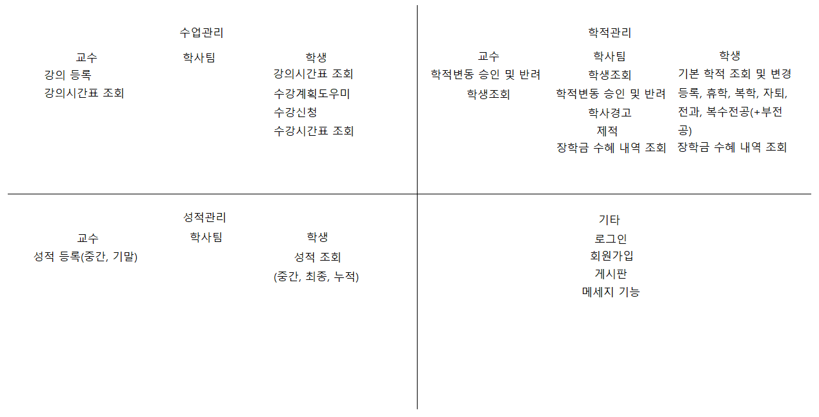
MEMBER
STU
PROF
ADMIN
COLLEGE
DEPT
LECTURE
BOARD
MESSAGE

